Slide 1
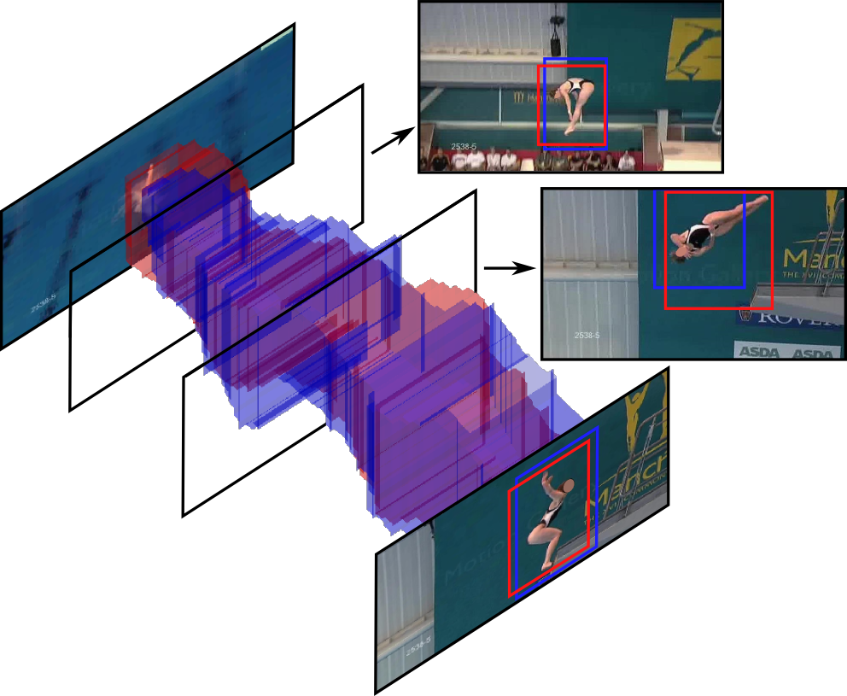
APT: Action localization Proposals
from dense Trajectories
Jan van Gemert, Mihir Jain, Ella Gati and Cees Snoek. BMVC 2015.

Slide 2
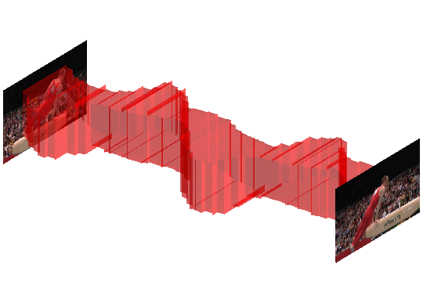
Action Localisation
Goal: Finding Where, When and What is happening
Challenges: Exponential search, Occlusion, Motion, Non-rigid deformations

Slide 3
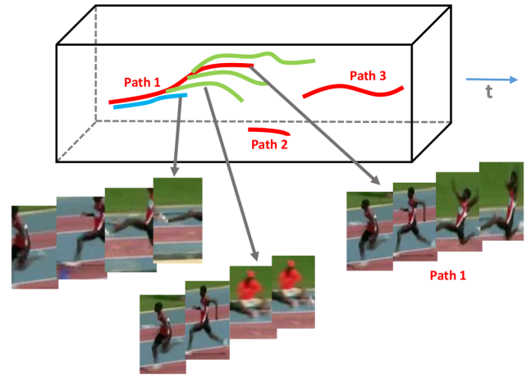
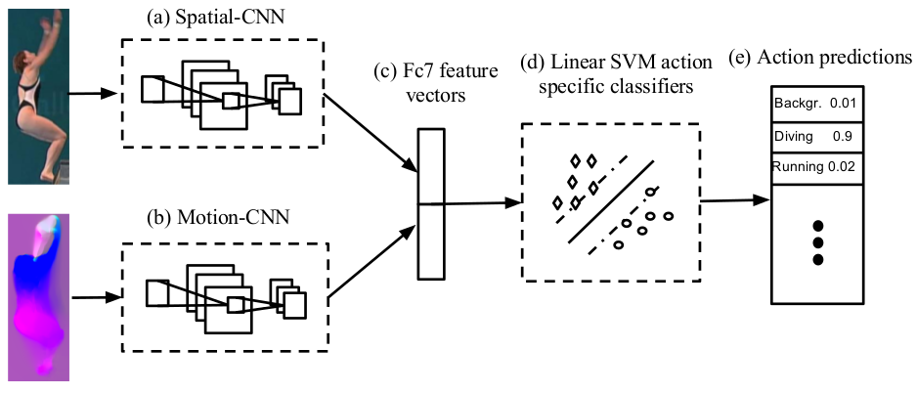
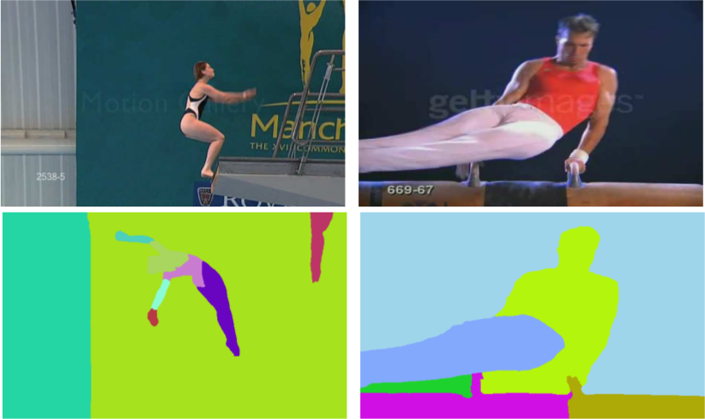
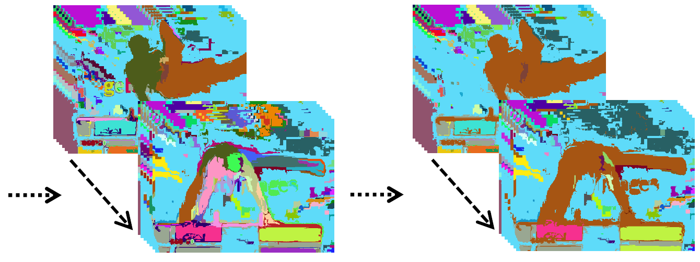
Current State of the Art
Detection: aggregate frame bounding box detection
[Yu, CVPR15]
[Gkioxari, CVPR15]
[Wein, ICCV15]
Proposals: a modest set of tubes retaining action recall
Prim3D:
[Oneata, ECCV14]
Tubelets:
[Jain, CVPR14]
We follow proposals: they are unsupervised and class-independent

Slide 4
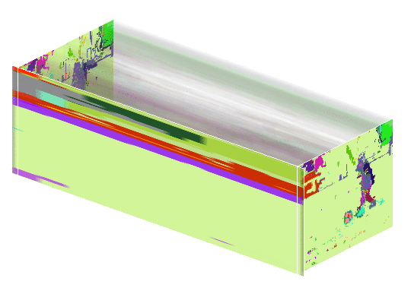
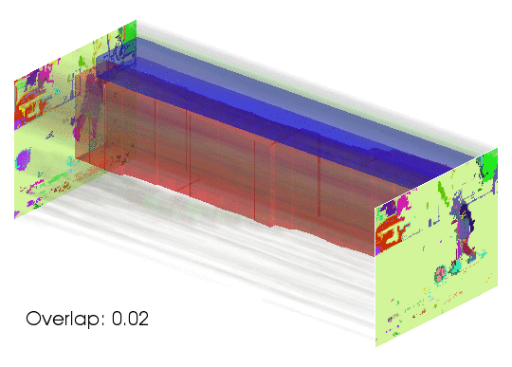
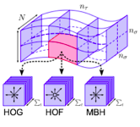
Current Proposal Methods
Prim3D:
[Oneata, ECCV14]
Tubelets:
[Jain, CVPR14]
Follow a 3 step procedure:
1) Segmentation
2) Grouping
3) Representation
Our motivation: questioning segmentation
- Time consuming
- Overly complex problem
We propose 2-steps:
- Skip segmentation
- Grouping proposals on the representation
- APT: Action Proposals from dense Trajectories
[Brox, ECCV10]

Slide 5
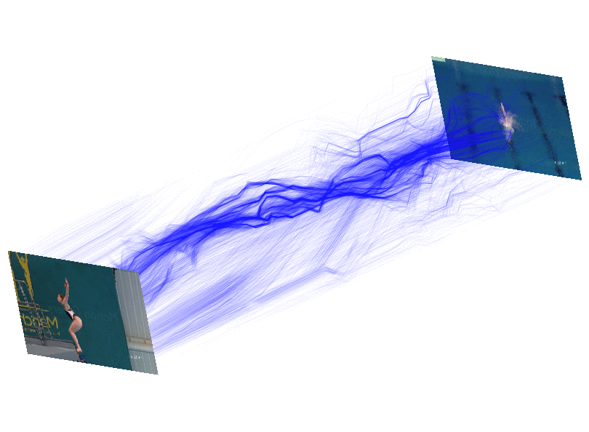
Can we use current approaches?
55 frames
14,334 trajectories
[Oneata,
ECCV14]
[Jain,
CVPR14]
Prim3D Tubelet APT
Unsupervised
Segmentation free
Time complexity
Space complexity
APT adopts the strengths of others, improving on large sets

Slide 6
Localized SLINK clustering
[Sibson, 1973]
Basis: single link hier. clustering (SLINK)
Our localized variant:
- only k-Nearest neighbors (k=10)
- Exact algorithmic speedup
- Proposal if 2 large clusters (>50) join
Spatio-temporal localization allows faster clustering

Slide 7
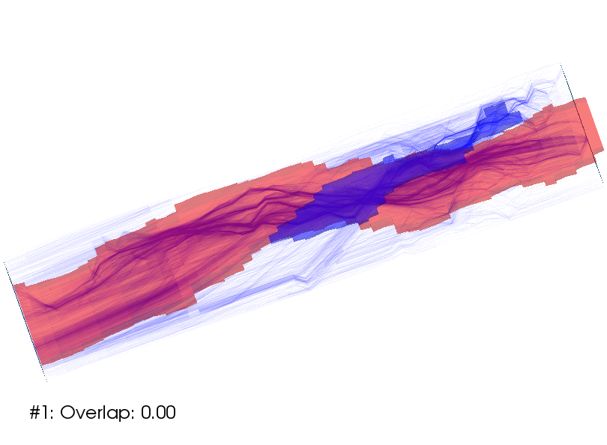
Group clusters to tube proposals
5 basic features:
spat, hog, hof, traj, mbh
All combinations:
2^5 = 32 variants
Diverse proposals:
focus on motion

Slide 8
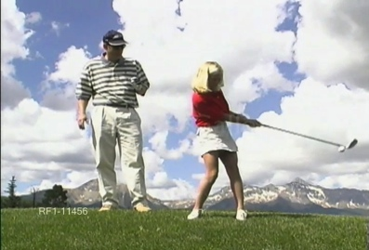
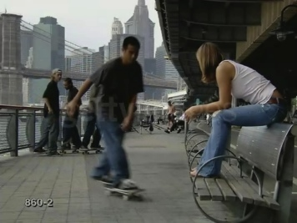
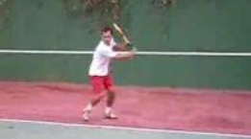
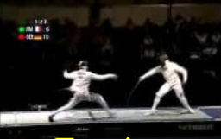
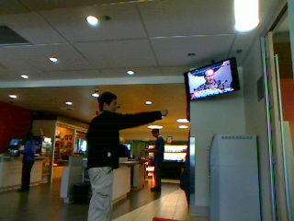
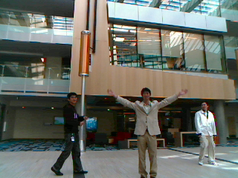
Evaluation datasets
Three Datasets:
UCF-Sports
Trimmed:
1: UCF-Sports: 150 vids; 10 actions
2: UCF-101: 3,204 vids; 24 actions
Untrimmed:
3: MSR-II: 54 vids, 3 actions
Golf swinging
Skate boarding
UCF-101
Classification
Tennis Swing
Fencing
Fisher Vector
One vs Rest
Hellinger Kernel SVM
MSR-II
Boxing
Hand waving

Slide 9
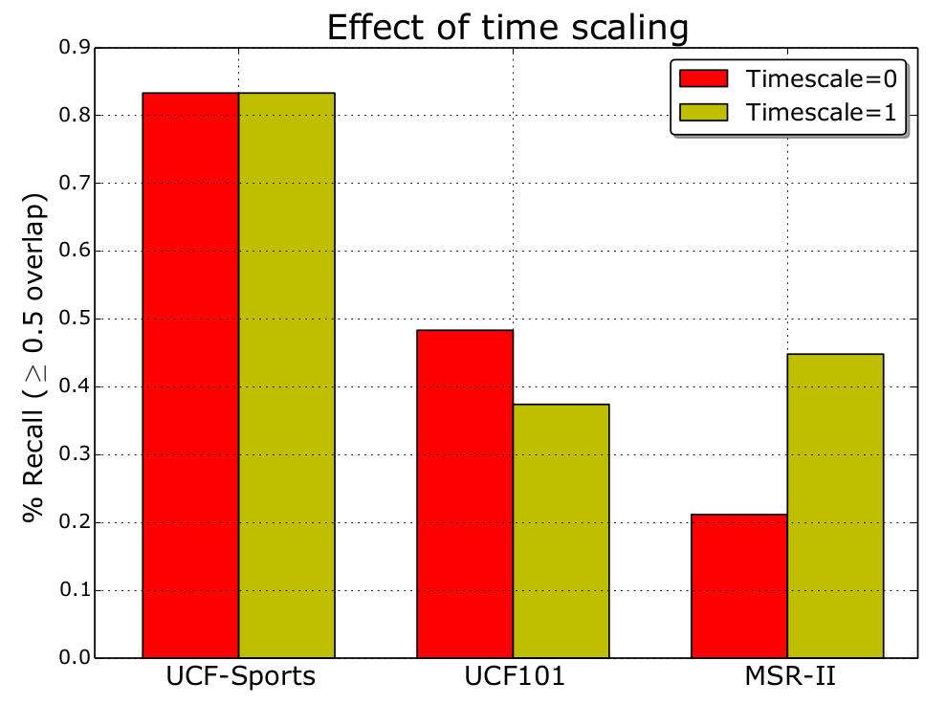
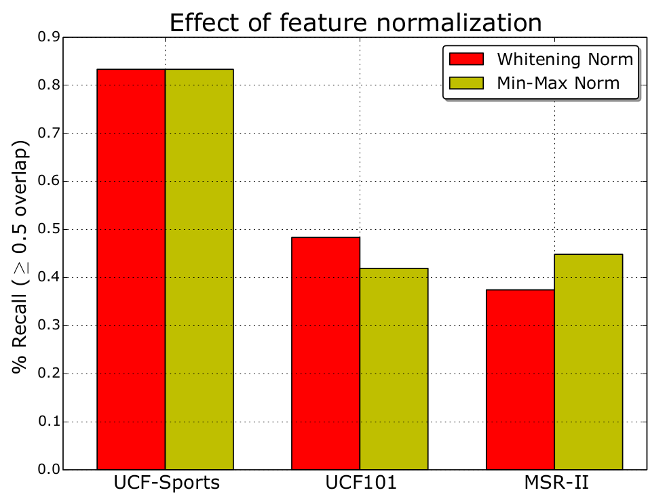
Evaluating APT properties
Conflicting best settings for
Trimmed (UCF-Sports, UCF-101)
Untrimmed (MSR-II)
Trimmed and untrimmed videos to be treated differently

Slide 10
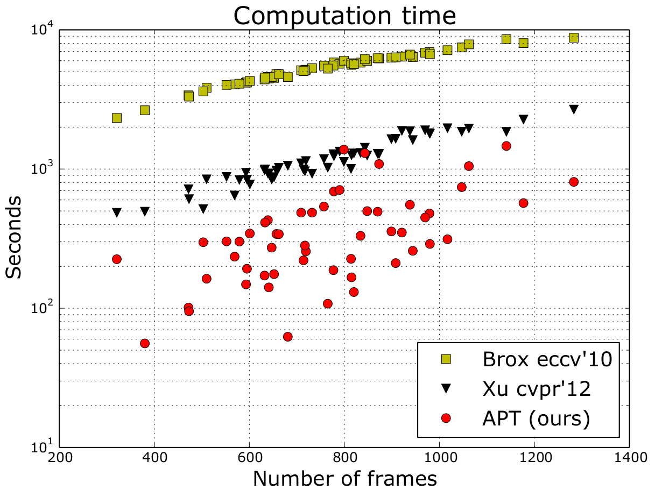
Computation speed on MSR-II
[Brox, ECCV10]
[Jain, CVPR14]
[Xu, CVPR12]
Compare against: Trajectory clustering and video segmentation
APT is faster than others, including segmentation preprocessing

Slide 11
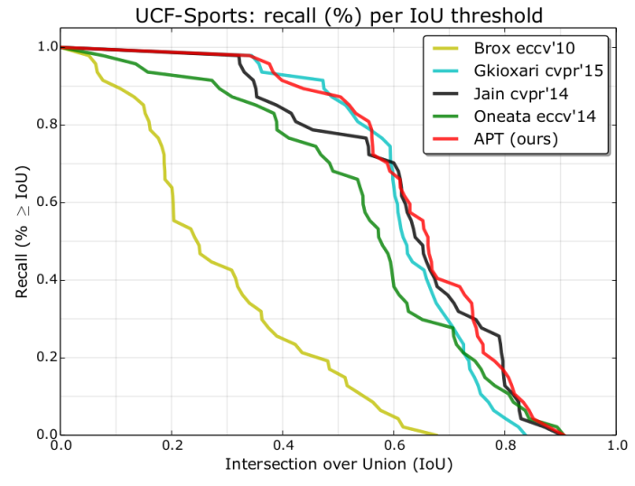
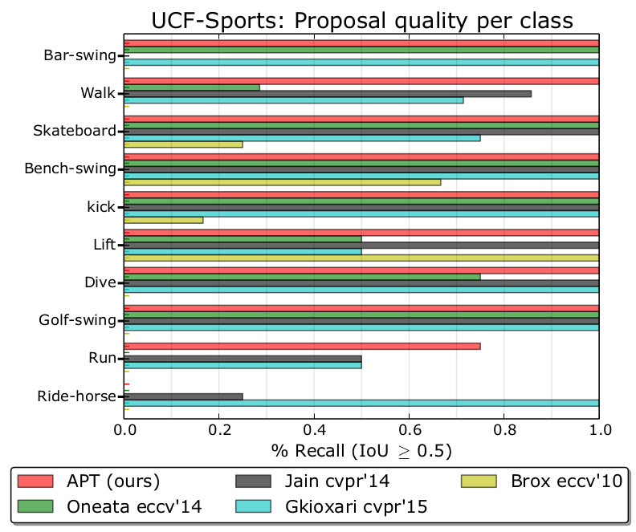
Evaluating proposal quality UCF-Sports

Slide 12
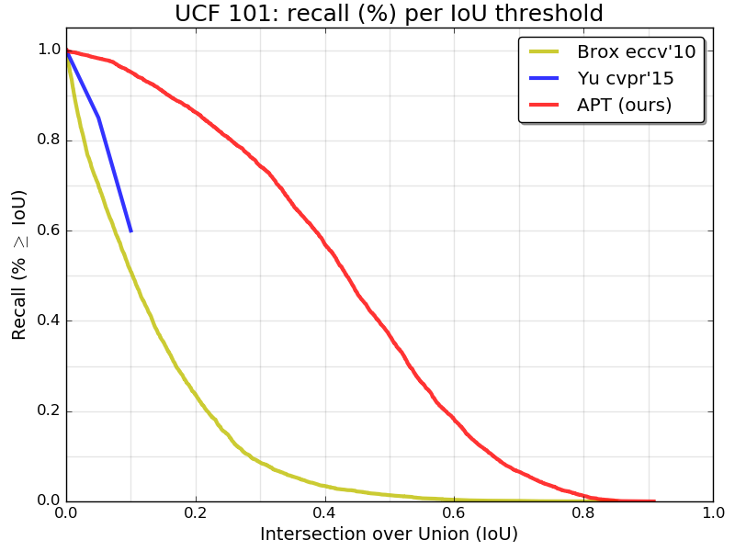
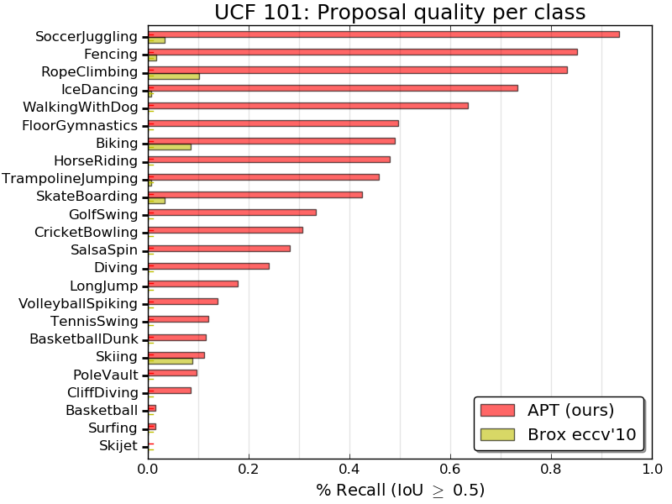
Evaluating proposal quality UCF-101

Slide 13
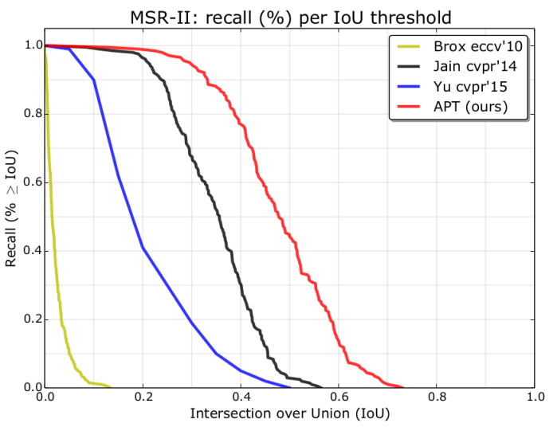
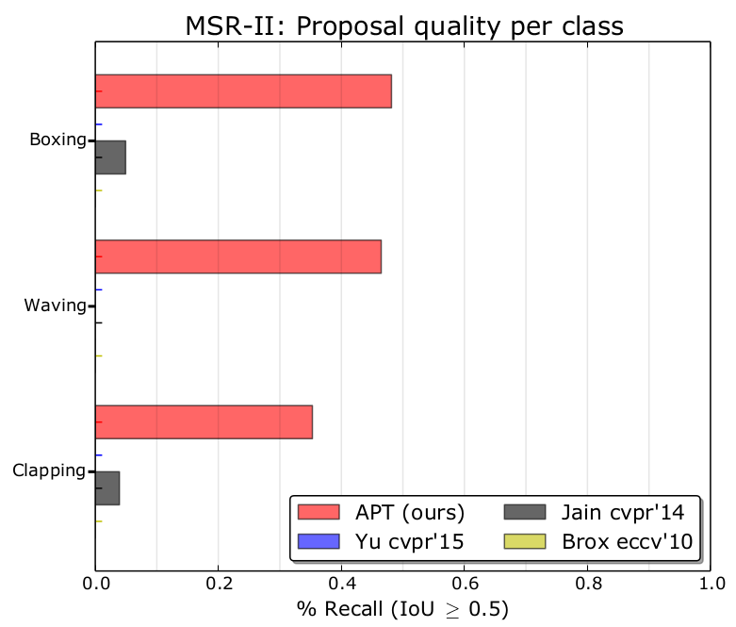
Evaluating proposal quality MSR-II

Slide 14
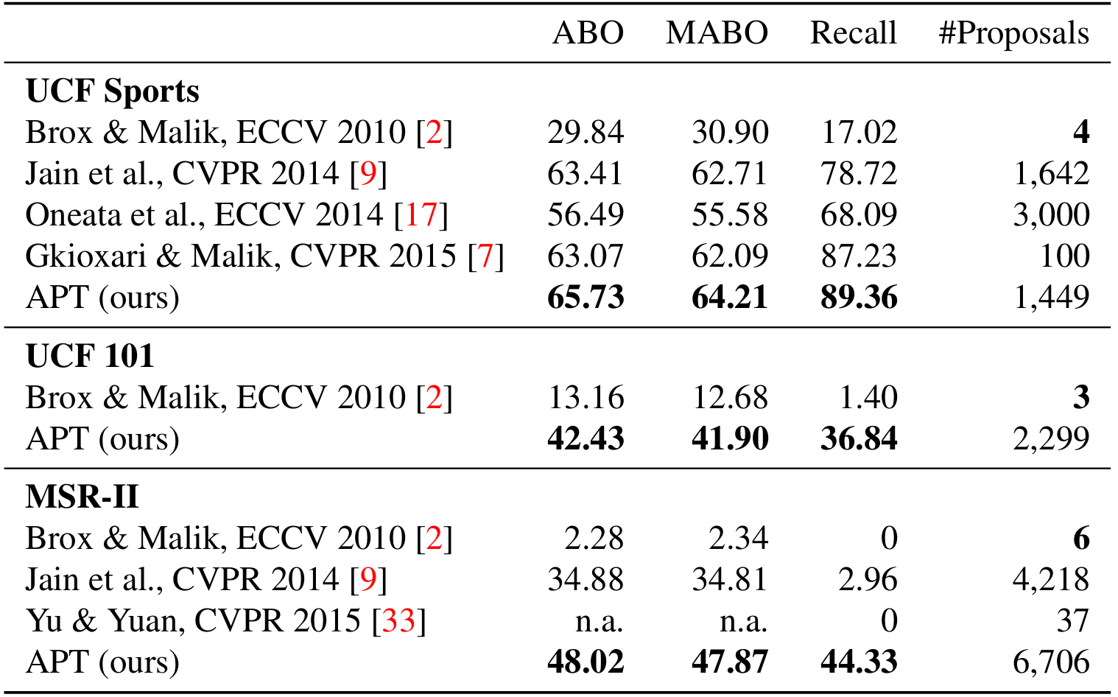
Evaluating proposal quality
APT outperforms others with a modest nr of proposals

Slide 15
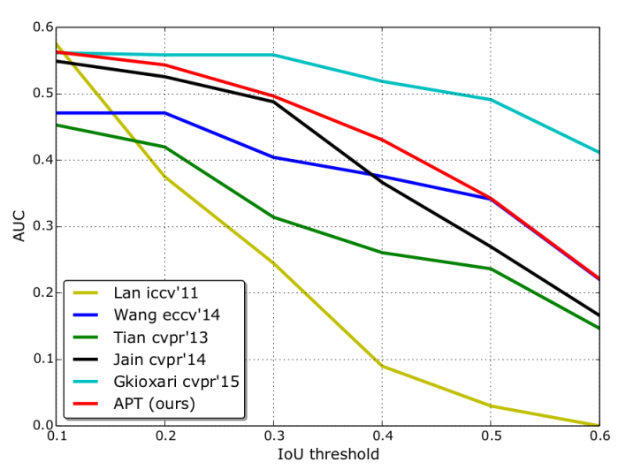
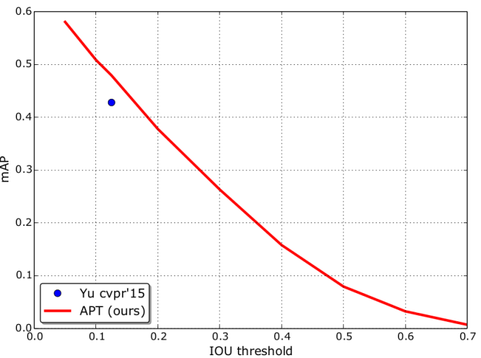
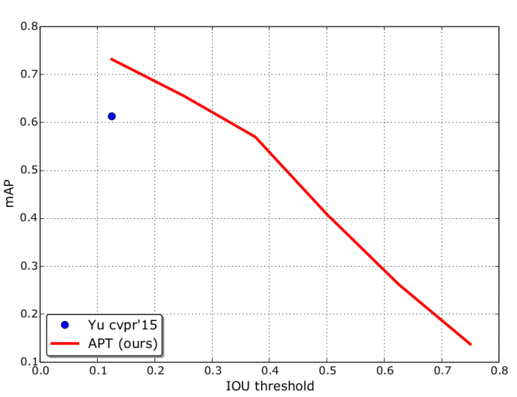
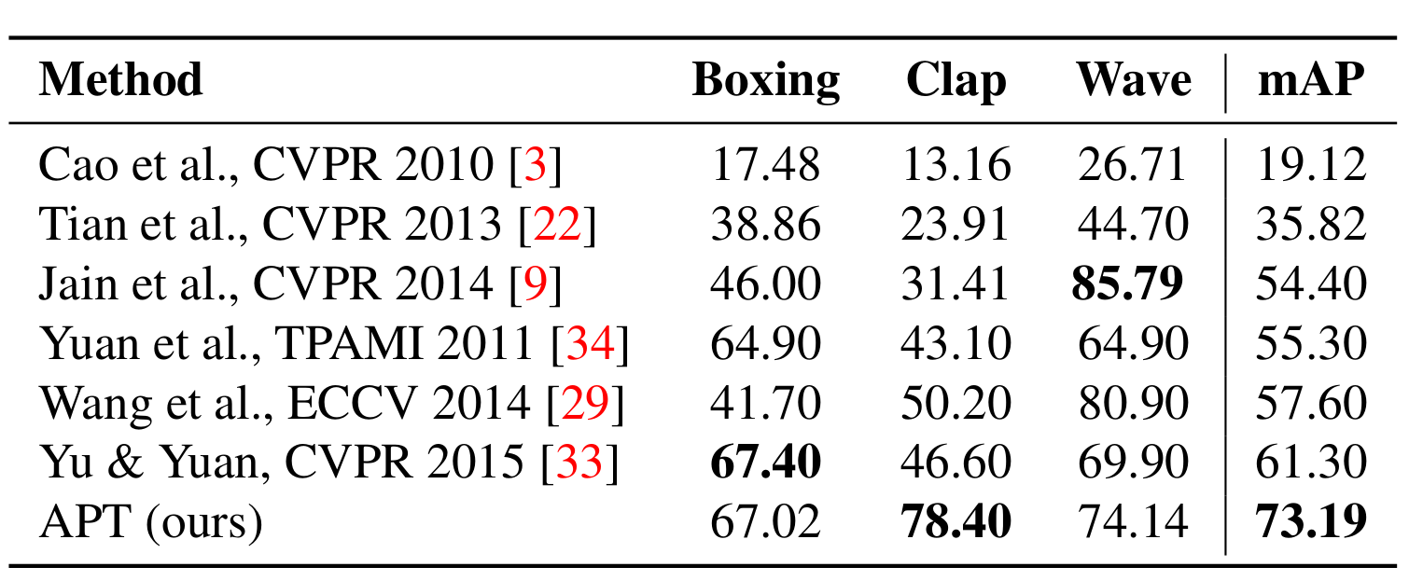
Using proposals for classification
UCF-Sports
UCF-101
MSR-II
Detailed MSR-II results:
APT is competitive with supervised methods; outperforms others

Slide 16
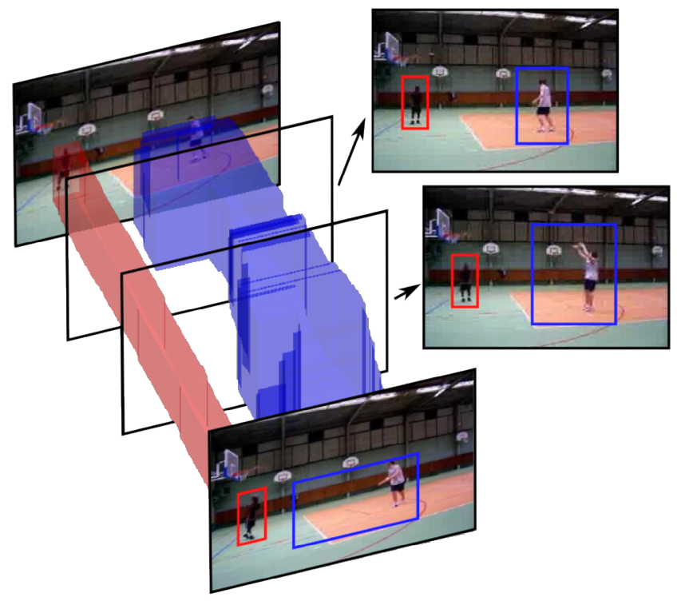
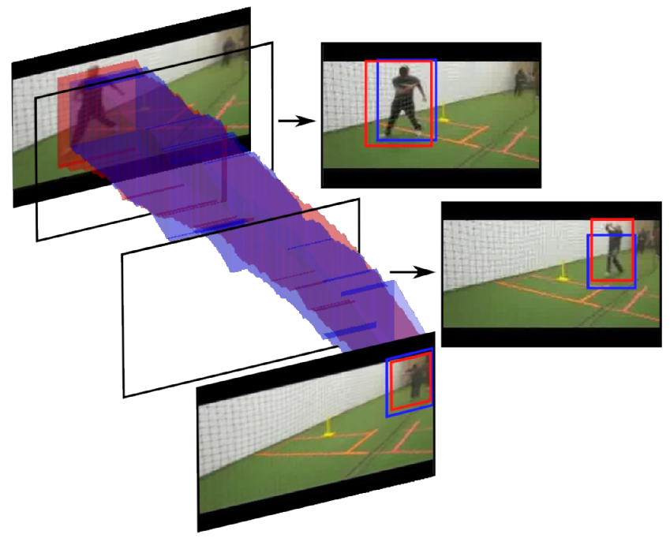
Visual results
Failure example
Successful example
APT works best when motion is present

Slide 17
APT: an apt method for spatio-temporal proposals
Reuse the same dense trajectories as used in the representation
More efficient than segmentation and other flow clustering
Outperforms others on proposal quality and classification on 3 sets.
Particularly effective for realistic untrimmed videos
Source code and pre-computed tubes
available on github
https://github.com/jvgemert

